Slide 1
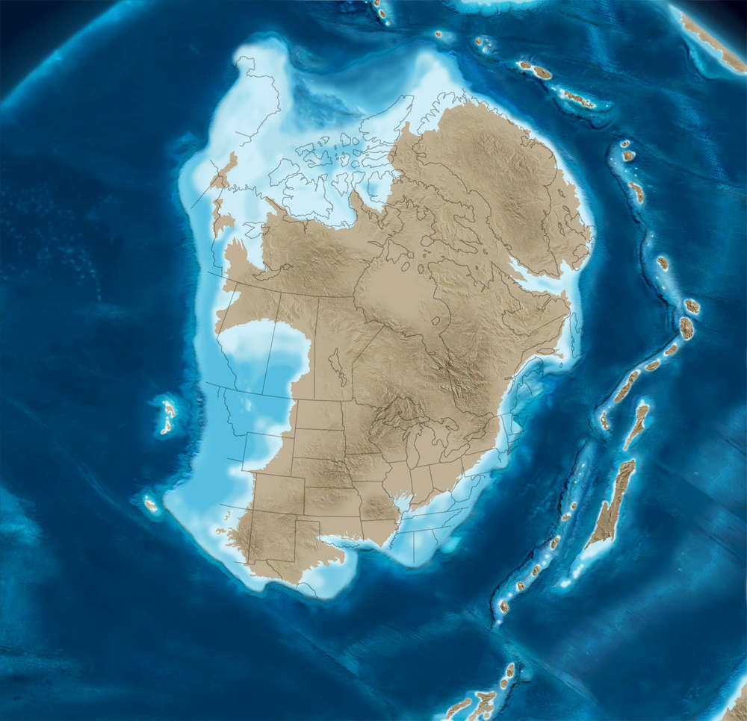
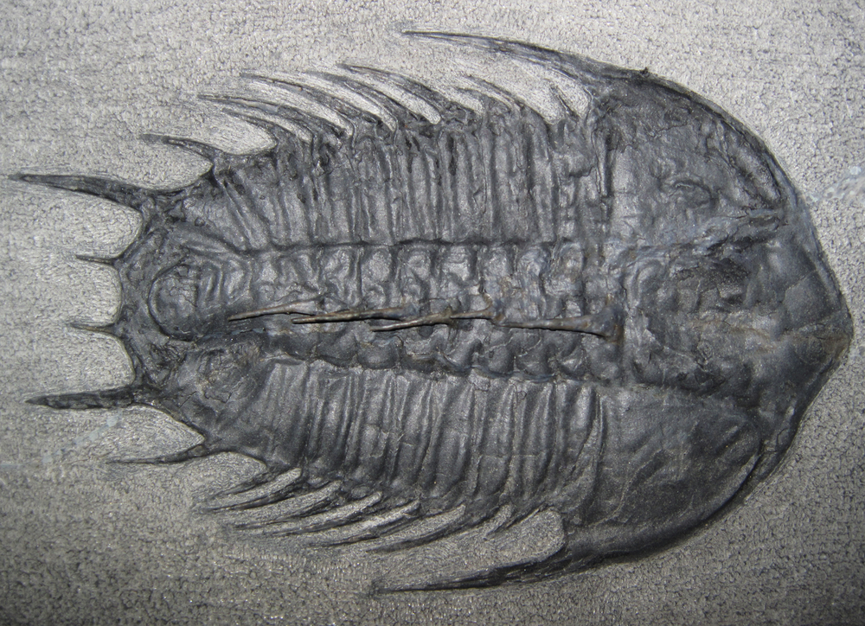
Detrital zircon reference for Cambrian to Triassic miogeoclinal strata of western North American
Gehrels, Dickinson, Ross, Stewart, Howell 1995

Slide 2
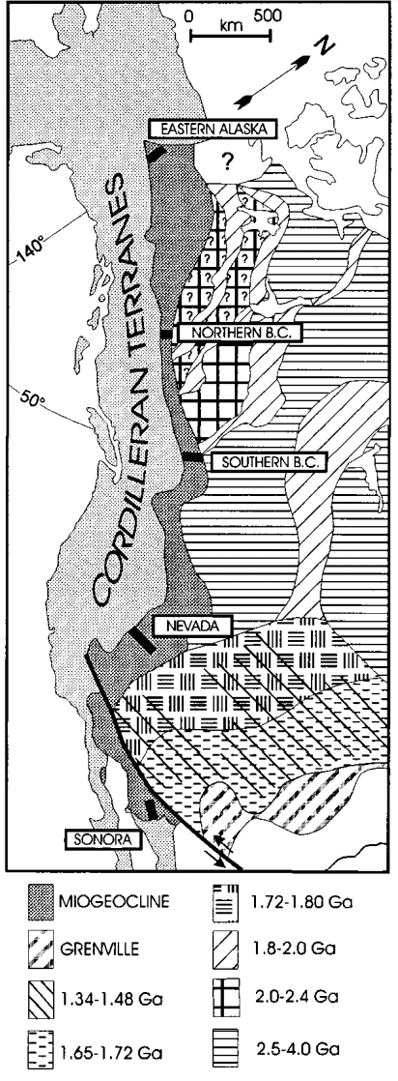
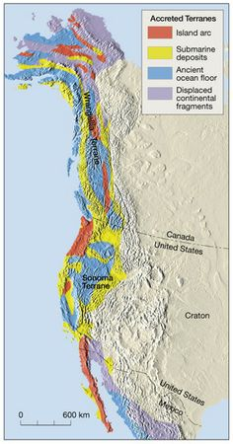
Most terranes formed in arc-type and ocean-floor environments outboard (west) of the Cordilleran miogeocline
Considerable debate about where many of the terranes formed and when they were accreted to western North America.
This paper uses detrital zircon ages to develop an additional technique for determining the displacement and accretionary history of these terranes.

Slide 3
Study conducted U-Pb analyses on 656 detrital zircon grains from strata of the Cordilleran miogeocline.
Age from Cambrian to Triassic
Larger (.100 mm) grains analyzed are concordant (95% confidence level), thus record crystallization ages.
Smaller grains yielded slightly to moderately discordant ages.

Slide 4
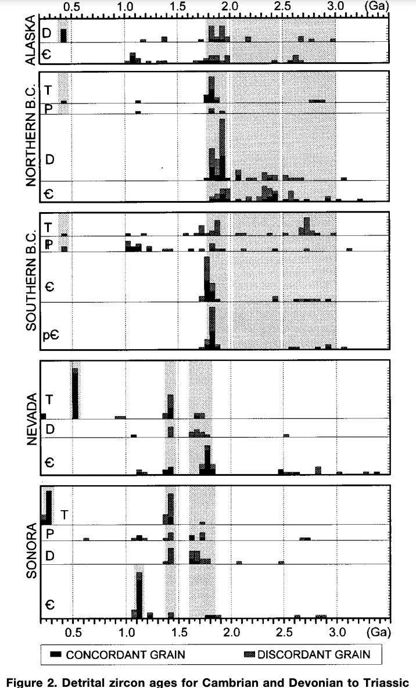
521 single-grain ages shown, 206 are analytically concordant and 315 are slightly to moderately discordant.
Solid boxes indicate ages that are concordant with analyses of high to moderate precision.
There are ‘significant’ latitudinal differences in the ages of detrital zircons in Cambrian and Devonian to Triassic strata.
These differences provide a reference for comparison with detrital zircon ages in potentially displaced strata outboard of the miogeocline.

Slide 5
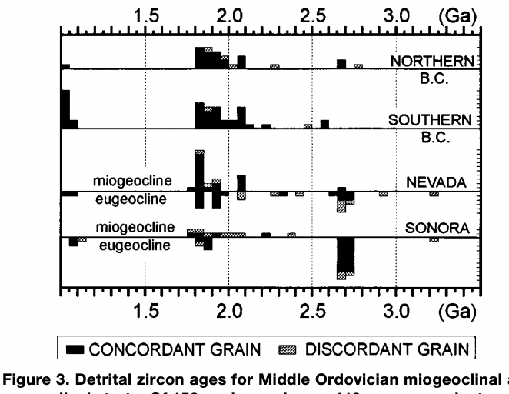
Ordovician sandstones from northwestern Canada to Sonora all yield similar ages of grains.
Zircons reaching the Cordilleran margin were derived fundamentally from local basement rocks.
Longshore transport along the continental margin was not significant on a 1000 km scale during Cambrian and Devonian to Triassic time.

Slide 6
Comparison of the ages of zircons in(Fig. 3) with the ages of grains in older and younger strata (Fig. 2) and with the ages of basement rocks along the Cordilleran margin indicates that most grains in Ordovician strata in Nevada and Sonora were not derived from nearby basement rocks.

Slide 7
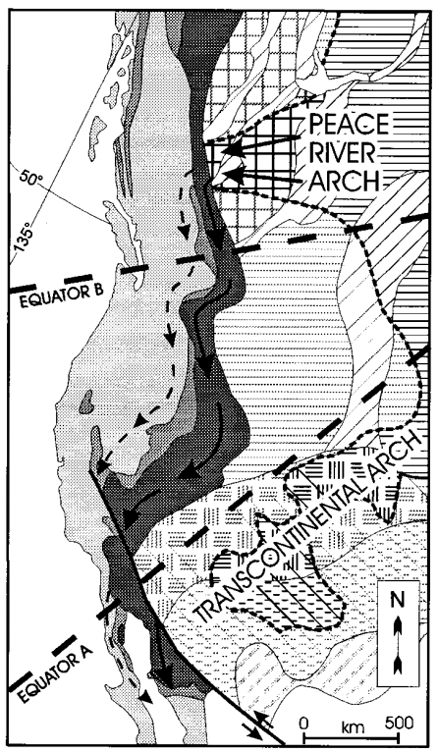
Most likely source of this material is the Peace River arch -- exposed Early Proterozoic and Late Archean rocks during much of early Paleozoic time.
Detritus from the Peace River arch was dominant along the margin because cratonal rocks to the south were covered by pre-Ordovician platformal strata and remained below sea level during much of Ordovician time.

Slide 8
Most detrital zircons accumulating along the margin were derived from nearby basement rocks.
No sign of significant fluvial transport of material from distant inland areas.
For off-shelf strata of Cambrian and Devonian through Triassic age, the pattern of ages serve as a reference for grains that were accumulating along the western edge of North America.
Paleolatitude cannot be determined for Ordovician time because there is no north-south variation in the ages of grains in Ordovician miogeoclinal strata.

